Slide 1
E-bay Auction Analysis
Group A
Raj Reddy
Ravi Bhadana
Shirali shah
SanJay DEvabathini

Slide 2
Table of content
Introduction
Data Sets
Specification
Work Flow
Implementation
Visualization
Conclusion
References

Slide 3
Introduction
Most exciting innovation on internet is Customer to customer auctions.
It is a multi billion dollar a year industry.
eBay has two different auction format. The common format is an English auction with a hard stop time.
Our objective of the project is to use apache spark Data frames for processing tabular data

Slide 4
This type of auction is used 87 % of our data set.
The bidders usually wait for last minute to bid in these auctions.
Second type of auction is Dutch auction. This auction is used when a person wants to auction 2 or 3 things.
eBay saves all information about closed auctions on their website for a month after the auction closes.
We collected the data from auction data source.

Slide 5
This project intends to analyze the real auction data from eBay auctions.
The tools used to analyze these datasets are Spark Dataframes, Hortonworks Sandbox of Microsoft Azure (Linux), Zeppelin, Tableau (Visualization).
The Query outputs are Visualized using different types of graphs and maps for better interpretation.

Slide 6
Data Sets
The dataset we have collected is 423.62MB.
Data Source: http://www.modelingonlineauctions.com/datasets
Our dataset consist of eBay online auction from 2008 to 2011 .
GitHub Link: https://github.com/ravibhadana90/ebay-auction-analysis
GitLab Link: https://gitlab.com/ravibhadana90/ebay-auction-analysis.git
Availability of this datasets of different "items" helps in performing the spark operations.

Slide 7
Specification
Microsoft Azure Hortonwork's Sandbox:
Linux System
Standard A4
No. Of nodes: 4
8 cores
Memory Size: 14 GB

Slide 8
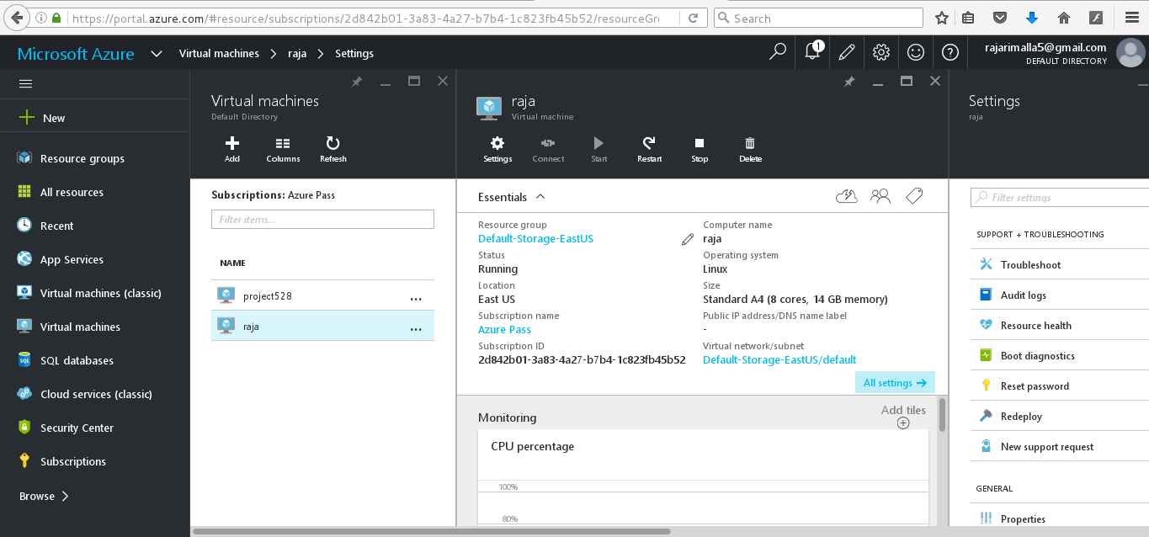
Azure hortonworks sandbox

Slide 9
Data fields
Auction_id - unique identifier of an auction
Bid - the proxy bid placed by a bidder
Bid_time - the time (in days) that the bid was placed, from the start of the auction
Bidder - eBay username of the bidder
Bidder_rate - eBay feedback rating of the bidder
Open_bid - the opening bid set by the seller
price - the closing price that the item sold for (equivalent to the second highest bid + an increment)
cities- the cities from where the bidders are.

Slide 10
Work flow
Data Sets
Processing the tabular data
Visualizing the Data
Uploading Data in Spark SQL table
Accessing Data Sets
Creating Data Frames

Slide 11
Implementation in spark
In this project we are creating spark dataframes and processing tabular data.
We are using Scala for coding.
For the creation and querying of the tables we are using the spark sql , sqlContext.

Slide 12
Using apache spark DataFrames with scala on the mapR sandbox The new spark dataFrames api is designed to make big data processing on tabular data easier. A Spark DataFrame is a distributed collection of data organized into named columns that provides operations to filter, group, or compute aggregates, and can be used with Spark SQL. DataFrames can be constructed from structured data files, existing RDDs, tables in Hive, or external databases.

Slide 13
Spark DataFrames
Using Spark Data frames we will explore the data with questions like:
How many auctions were held?
How many bids were made per item?
What's the minimum, maximum and average number of bids per items?
Show the bids with price >100
Data related to Cities.

Slide 14
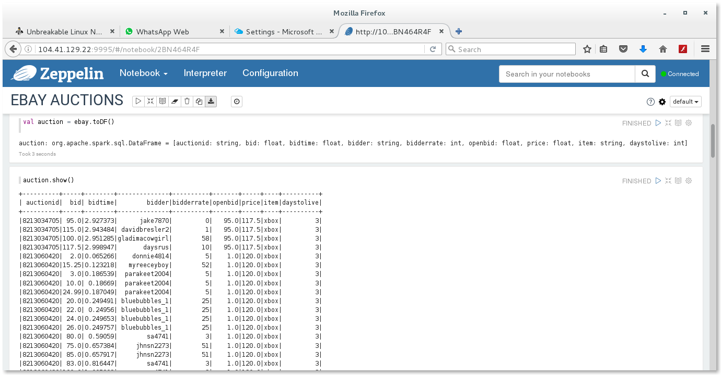
Exploring the data

Slide 15
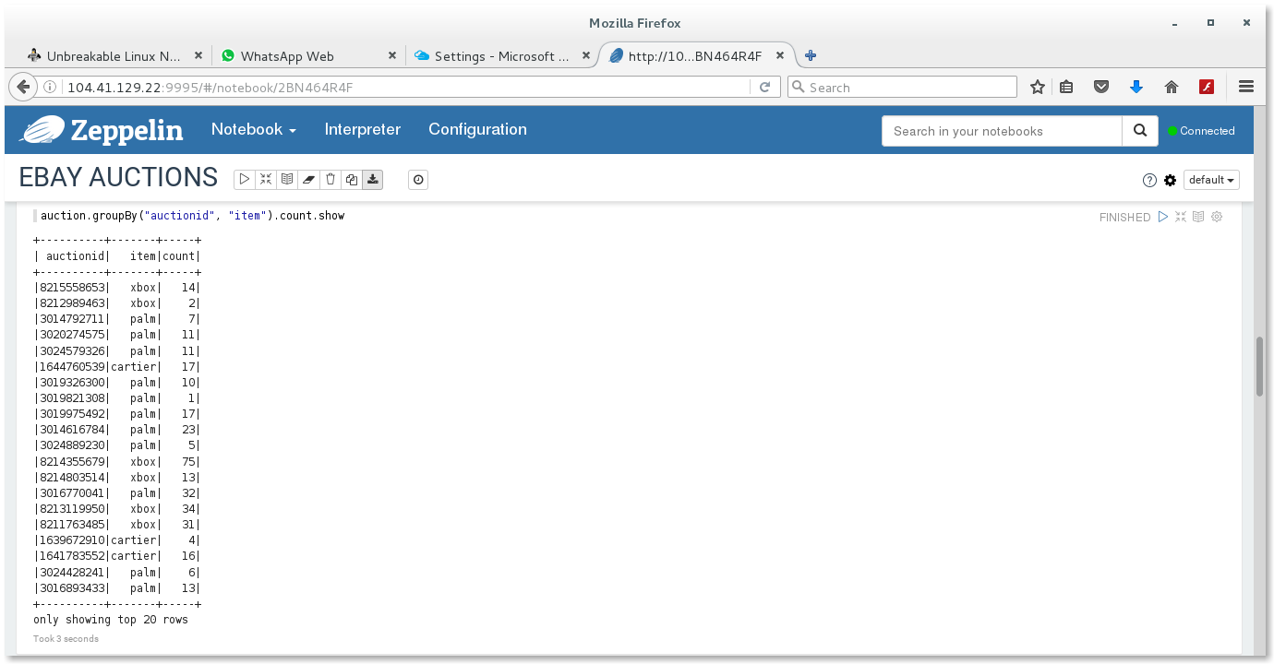
No. Of bids per item

Slide 16
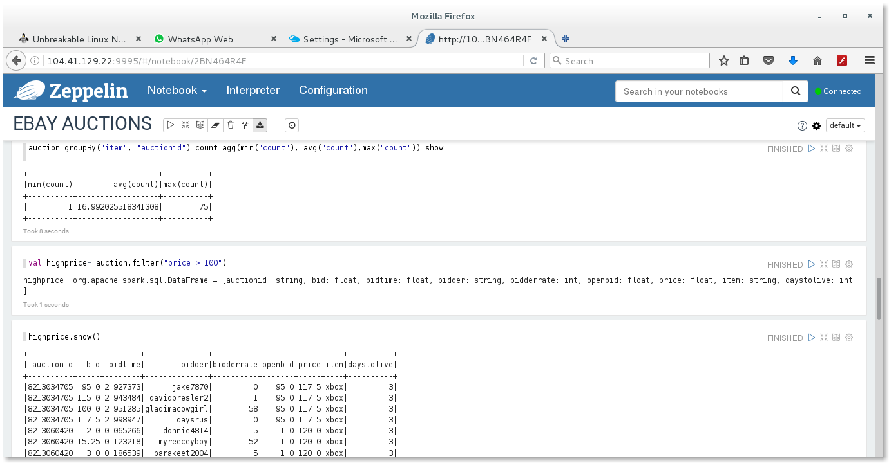
the auctions with closing price > 100

Slide 17
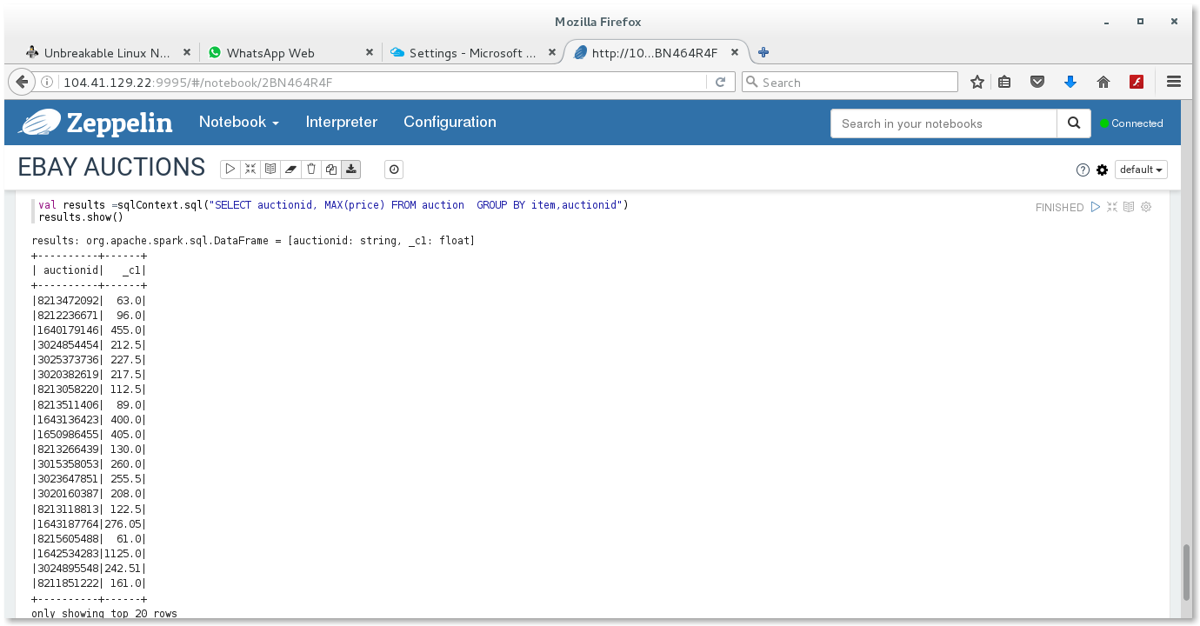
Displaying the data frames in tabular format

Slide 18
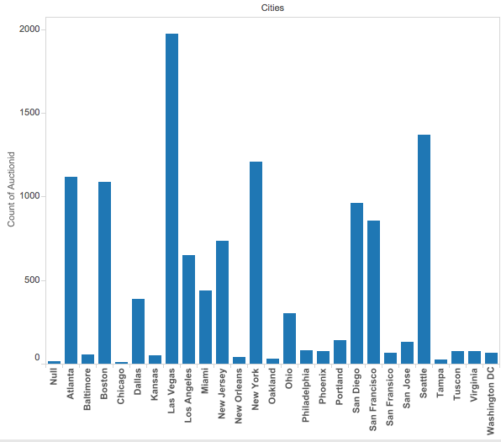
Visualization
Number of Auctions taking place in Major Cities

Slide 19
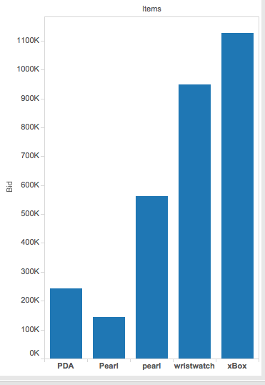
Total number of bids for each items

Slide 20
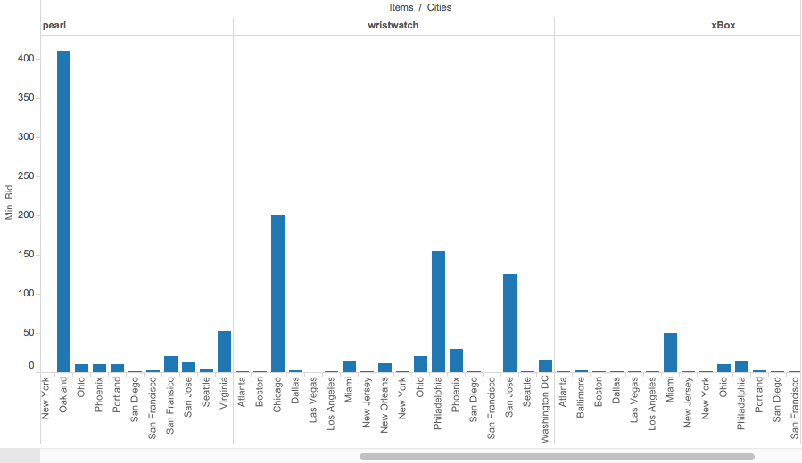
Amount of minimum bid taking place of the items in different cities

Slide 21
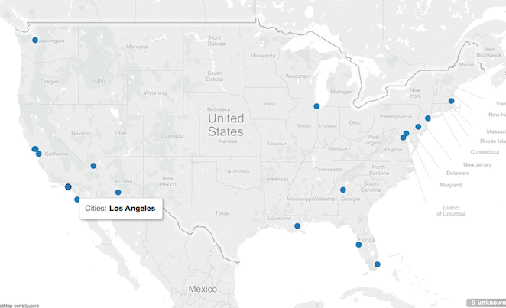
The data of auctions from major cities

Slide 22
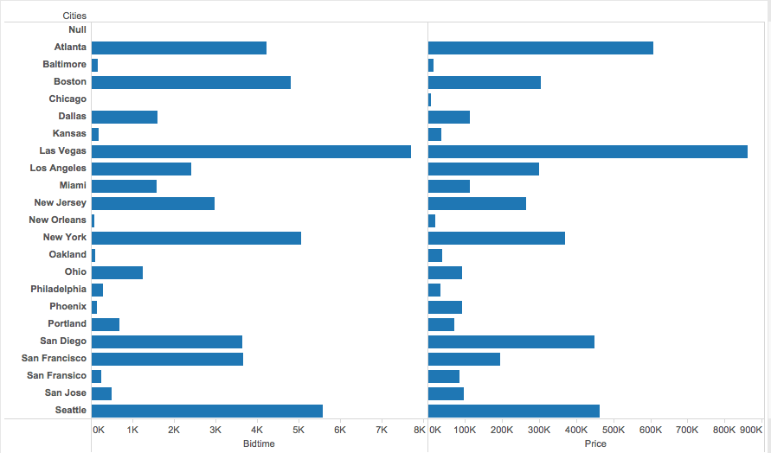
Total Bid-time and price per cities

Slide 23
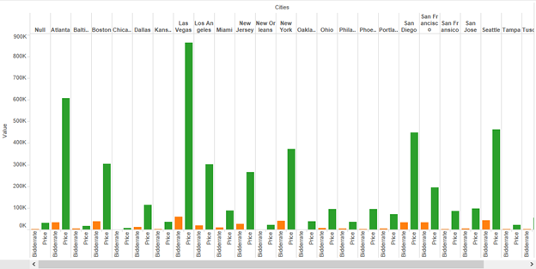
Bid-rates and Price in the Cities

Slide 24
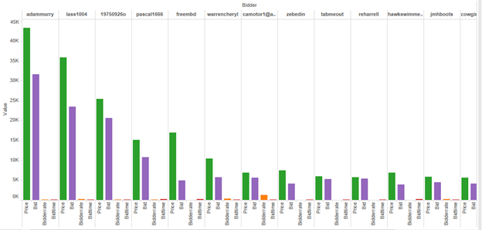
No. Of Bidders : Bid-rate and Price

Slide 25
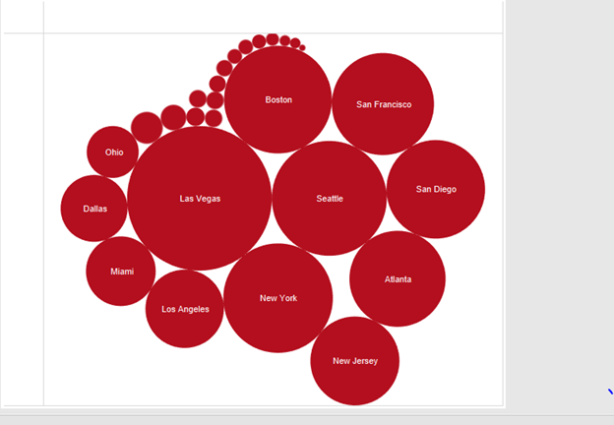
The amount of bidding taking place in cities

Slide 26
Conclusion
By the queried results the company can use this analysis for the future auctions.
These results can also be used to get information about the auctions rounding up the cities.

Slide 27
Challenges, What we learned
When we used python the process was slow as we were processing huge amount of data, but then we used scala it was quick.
We tried our code on Databricks due to lack of experience on databricks we were enable to process the data.
From our class experience we learned how to process data on Zeppelin.
We experimented on Spark SQL and Scala SQLContext.
We learned to use Spark Dataframes.

Slide 28
Reference
www.ebay.com/auctions
modelingonlineauctions.com
http://www.modelingonlineauctions.com/datasets
https://www.mapr.com/blog/using-apache-spark-dataframes-processing-tabular-data

Slide 29
Thank You
Any Questions?

